Slide 1




Nottinghamshire Police and Crime Survey Public Confidence Profiles
July 2022

Slide 2

Nottinghamshire Police and Crime Survey to June 2022
Public Confidence in the Police in your local area

Slide 3
About the survey
The Police and Crime Survey is commissioned by the Nottinghamshire Police & Crime Commissioner and has been undertaken on a quarterly basis across the police force area since June 2017
The survey robustly captures and tracks indicators of public trust and confidence in the police and resident’s experience of crime and ASB and their satisfaction with any policing services received
The survey uses an ‘assisted self-completion’ method, where teams of interviewers distribute questionnaires, offer support in completing them and return later to collect them if help is not required
The survey achieves over 4,260 responses per year based on a sampling scheme representative of the local population at local authority level by age, gender, employment status and ethnicity
Sampling points are set at Lower Super Output Area (LSOA) level to ensure good geographic coverage. Residents from all of Nottinghamshire’s 697 LSOAs are surveyed over a two year period
Quarterly waves of fieldwork help to minimise skews that can be caused by seasonality or significant events. The LSOAs in which fieldwork is undertaken each quarter are evenly distributed by deprivation and population profile
The survey provides a margin of error of +/-3% at the 95% confidence level across the force area. Responses are aggregated to report on the most recent 12 month rolling period each quarter.

Slide 4
Latest fieldwork and sample size
The latest wave of fieldwork was undertaken between 14 May and 6 June 2022 under conditions compliant with the Market Research Society code of practice. In this wave, a total of 1,096 questionnaires were completed.
One in eight LSOAs were selected from each of the following geographic areas:
Nottingham
South Nottinghamshire - comprising Gedling, Broxtowe and Rushcliffe
Bassetlaw, Newark and Sherwood
Mansfield and Ashfield
The survey achieved a sample of 4,324 respondents over the latest reporting period, broken down as follows:-
Area | Local Authority | Year to Jun 18 Unweighted Count | Year to Jun 19 Unweighted Count | Year to Jun 20 Unweighted Count | Year to Jun 21 Unweighted Count | Year to Jun 22 Unweighted Count
Bassetlaw, Newark and Sherwood | Bassetlaw | 577 | 477 | 569 | 536 | 527
 | Newark & Sherwood | 519 | 599 | 508 | 542 | 554
 | Total | 1,096 | 1,076 | 1,077 | 1,078 | 1,081
Mansfield and Ashfield | Ashfield | 600 | 559 | 546 | 547 | 587
 | Mansfield | 500 | 555 | 530 | 531 | 494
 | Total | 1,100 | 1114 | 1,076 | 1,078 | 1,081
Nottingham | Nottingham | 1,087 | 1,062 | 1,075 | 1,071 | 1,081
South Notts | Broxtowe | 378 | 342 | 343 | 360 | 335
 | Gedling | 368 | 426 | 362 | 386 | 385
 | Rushcliffe | 374 | 322 | 372 | 337 | 361
 | Total | 1,120 | 1,090 | 1,077 | 1,083 | 1,081
FORCE | Total | 4,403 | 4,342 | 4,305 | 4,310 | 4,324

Slide 5
Public Confidence in the police in your area
Please say how much you agree or disagree with each of the following statements about the police in your local area. By local area we mean within a 15-minute walk of your home.
You don’t need to have had contact with the police, we are interested in your opinion based on what you know. So, would you say the police in your area…
Public Confidence question set:
…Respond appropriately to calls for help and assistance
…Take people’s concerns seriously
…Treat people fairly and with respect
…Have a good reputation amongst local people
…Understand the crime and ASB issues in the area where you live
…Are dealing with the crime and ASB issues that matter to you
Taking everything into account, I have confidence in the police in this area

Slide 6
Public Confidence in the police in your area
Please say how much you agree or disagree with each of the following statements about the police in your local area. By local area we mean within a 15-minute walk of your home.
You don’t need to have had contact with the police, we are interested in your opinion based on what you know. So, would you say the police in your area…
Public Confidence question set:
…are effective in providing advice or guidance to the public
…are effective in providing a visible presence in the areas of greatest need
…are effective in working to prevent crime
…are effective at investigating crime and catching criminals
…are effective in protecting vulnerable people from harm
…provide good value for money
Taking everything into account, the police in this area are doing a good job

Slide 7
Observations
Public confidence in the police peaked across all Community Safety Partnership during the period of coronavirus restrictions. Since summer 2021, however, public confidence has been in steady decline, in some cases falling below the pre-pandemic baseline
This trend has been reflected across other forces tracking public confidence – indicating that national issues are likely to be an influencing factor. Local analysis, however, highlights a range of geographic and demographic variations that present opportunities to affect local trends in public confidence
Public confidence in the police has deteriorated among females since March 2020, particularly with regard to perceptions that the police have a good reputation and treat people fairly and with respect. Equivalent reductions in feelings of safety outside in the area after dark indicate that national media, including the murder of Sarah Everard in 2021, is likely to have impacted upon this trend.
Opportunities to drive improvements in public confidence in policing vary by geographic area, with:
Police visibility being the main factor in rural localities (Bassetlaw, Newark & Sherwood)
Visibility and activity to address local concerns being key to improvement in the conurbation
The reputation of police being the main factor in urban localities (Nottingham, Mansfield)
As key drivers of public confidence, it will be important to understand what factors have contributed to:
Increases in perceptions that the police are visible where needed and are dealing with issues of greatest community concern in Ashfield and Mansfield since March 2020
Improvements in reputation of police in Ashfield and Newark and Sherwood since March 2020
Reductions in perceptions that the police understand and are dealing with the issues that matter most to communities among South Nottinghamshire local authorities since March 2020.

Slide 8
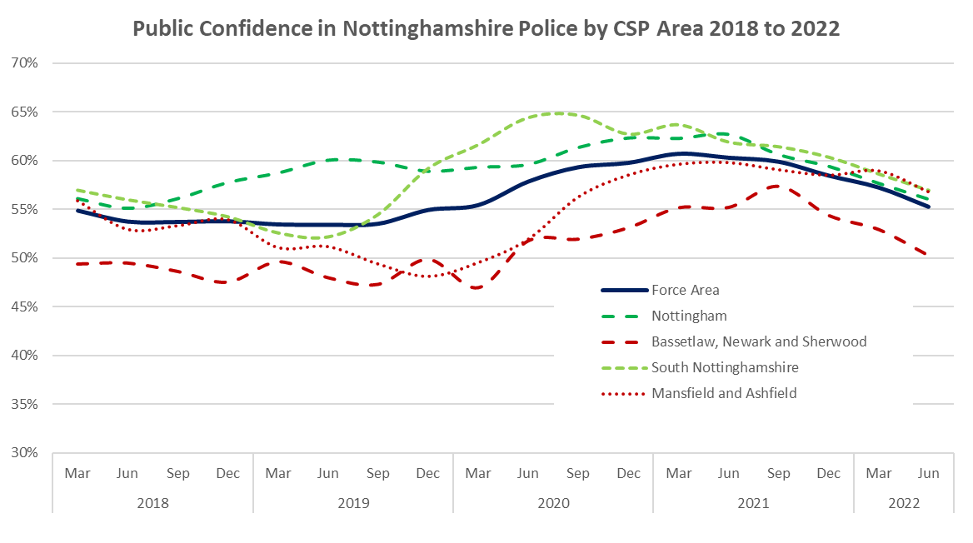
Public Confidence in the police in your area

Slide 9
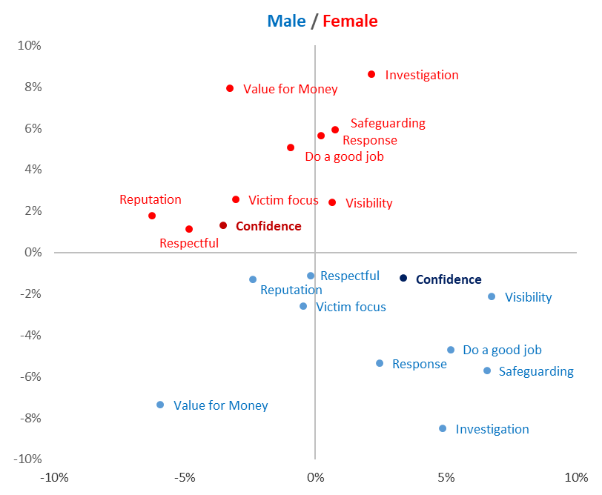
Public Confidence in the Police by Gender
Confidence in the police remains higher among females than males across all key indicators, however the gap has narrowed on account of overall confidence improving among males and deteriorating among females since March 2020.
Perceptions of police effectiveness have improved among males and females re.
providing visible presence where needed
investigating crime and catching criminals
protecting vulnerable people
Perceptions of police effectiveness have deteriorated among males and females re.
Providing good value for money and
Having a good reputation locally
Treating people fairly and with respect
Factors most likely to drive improvements in public confidence among females include:
Improving perception that the police have a good reputation in the area and
Improving perception that the police treat people fairly and with respect
There are also opportunities to drive improvements in perceptions among males that the police good value for money
Better than average
Worse than average
Deterioration
Improvement

Slide 10
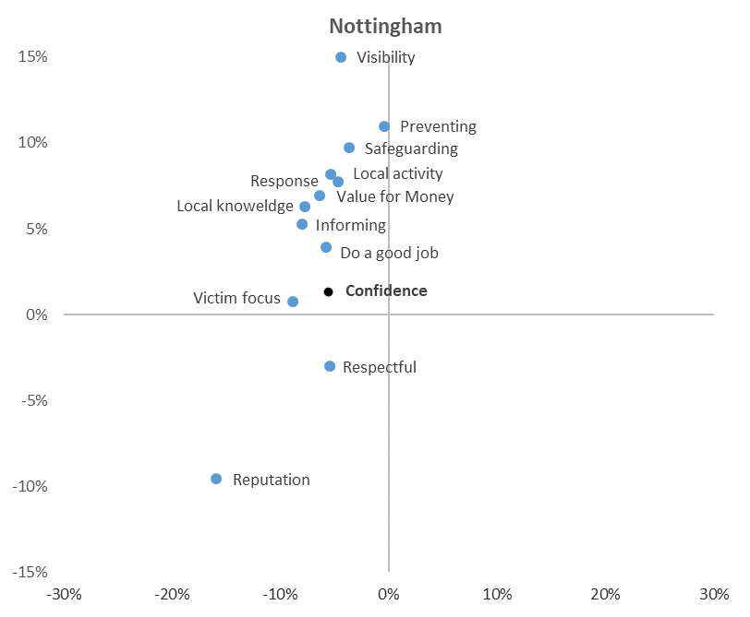
Public Confidence in the Police in Nottingham
Confidence in the police has deteriorated slightly in Nottingham since the March 2020. This is likely to have been affected by reductions in perceptions that the police have a good reputation in the area and take people’s concerns seriously.
Despite this, most indicators of public confidence remain higher than the force average in Nottinghamshire, particularly with regard to those feeling that the police are effective at providing a visible presence where needed.
There remain opportunities to further improve perceptions that the police have a good reputation in the area.
Better than average
Worse than average
Deterioration
Improvement

Slide 11
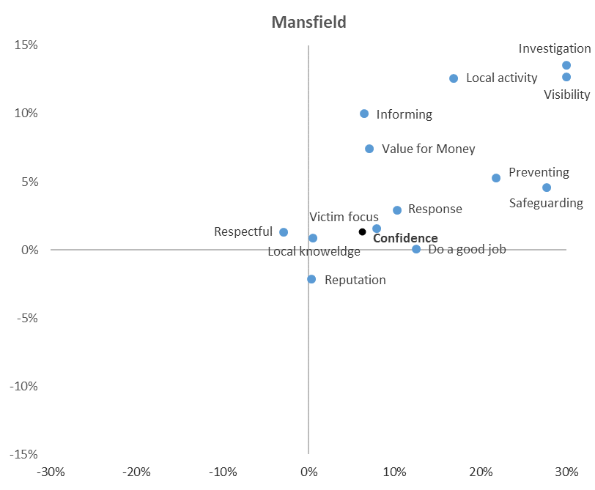
Public Confidence in the Police in Mansfield
Confidence in the police has increased in Mansfield since March 2020. This is likely to have been influenced by improvements in police visibility and activity to tackle issues of greatest local concern.
Consequently, there have also been marked improvements in the proportion of respondents feeling that the police are effective in preventing and investigating crime.
There are no areas in which public confidence in the police has seen a significant deterioration or falls significantly below the March 2022 baseline.
Despite this positive picture, there are opportunities to further improve perceptions that the police have a good reputation in the area and treat people fairly and with respect.
Better than average
Worse than average
Deterioration
Improvement

Slide 12
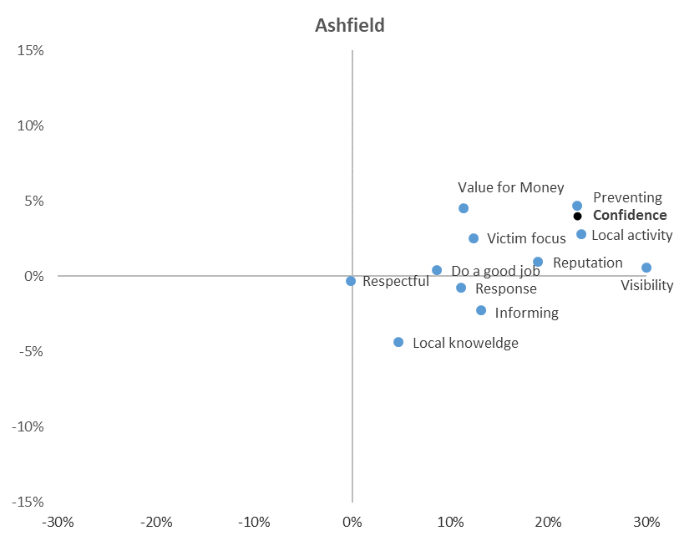
Public Confidence in the Police in Ashfield
Confidence in the police has increased significantly in Ashfield since March 2020. This is likely to have been influenced by improvements in police visibility and local activity in the area, particularly in proactive work to prevent crime.
There have been notable improvements in public perceptions of the police in terms of:
providing visible presence where needed
dealing with local crime and ASB issues
working to prevent crime and ASB
There are no areas in which public confidence in the police has fallen significantly below the March 2022 baseline in Ashfield.
Despite this positive picture, the proportion respondents feeling that the police understand the crime and community safety issues affecting their area remains below the force average.
Better than average
Worse than average
Deterioration
Improvement

Slide 13
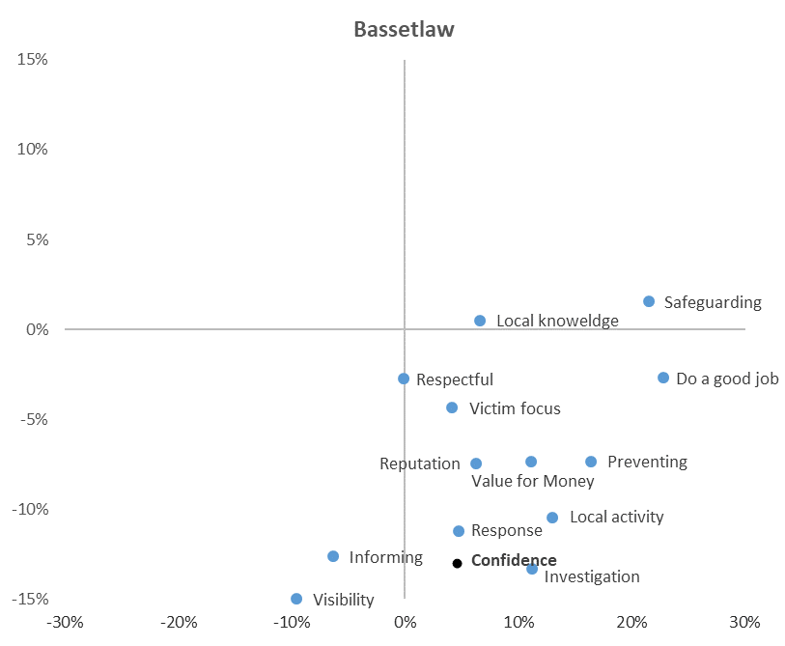
Public Confidence in the Police in Bassetlaw
Confidence in the police has increased in Bassetlaw since March 2020, with improvements seen across the vast majority of indicators.
The most notable improvements have been in perceptions that the police are effective in safeguarding vulnerable people, preventing crime and dealing with the issues that matter to local people.
The proportion of respondents feeling that the police ‘do a good job’ has also increased significantly, despite a deterioration in the proportion of respondents feeling that the police are visible where needed.
Despite an improving picture, public confidence across the majority of indicators remains significantly lower than the force average.
Visibility is the factor most likely to drive improvements in public confidence in Bassetlaw.
Better than average
Worse than average
Deterioration
Improvement

Slide 14
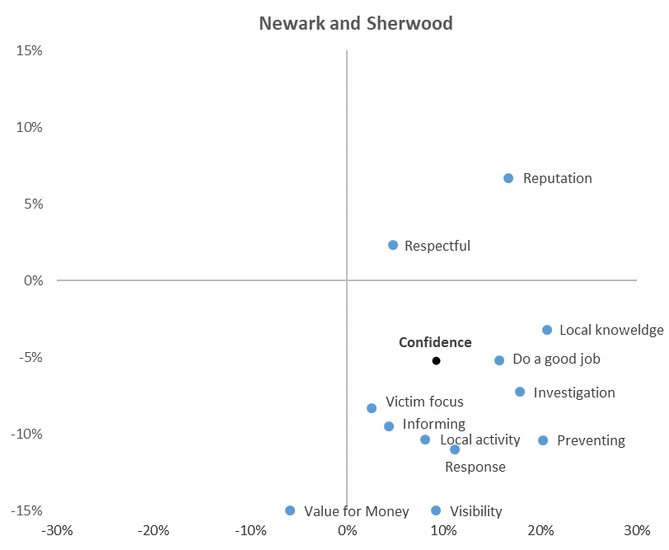
Public Confidence in the Police in Newark and Sherwood
Confidence in the police has increased in Newark and Sherwood since March 2020, with improvements seen across almost all indicators.
The most notable improvements have been in perceptions that the police understand the issues affecting their community and are effective in investigating and preventing crime.
Despite an improving picture, public confidence across the majority of indicators remains significantly lower than the force average. The only exceptions to this are the perception that the police have a good reputation in the area and treat people fairly and with respect – both of which remain stronger than the force average.
Visibility and value for money are the factors most likely to drive improvements in public confidence in Newark and Sherwood.
Better than average
Worse than average
Deterioration
Improvement

Slide 15
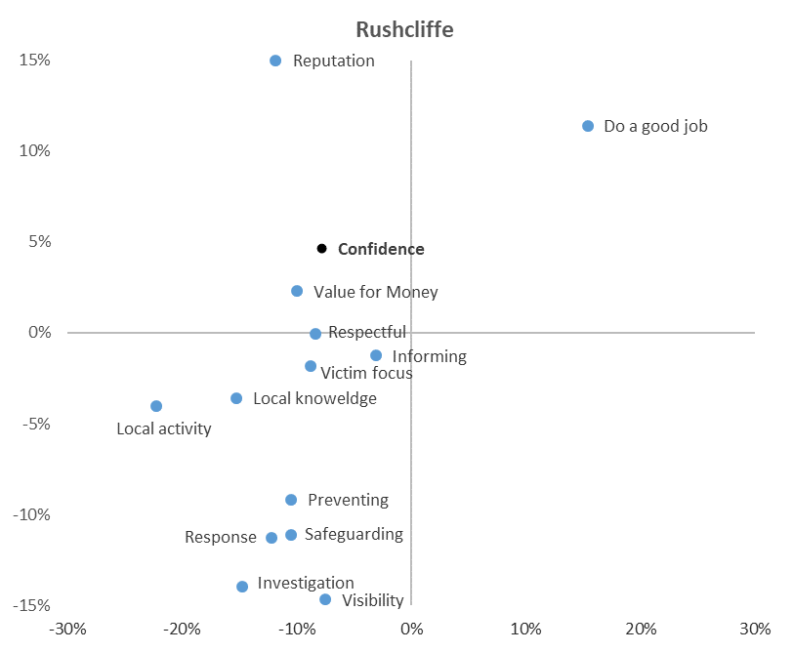
Public Confidence in the Police in Rushcliffe
Confidence in the police has deteriorated slightly in Rushcliffe since March 2020. This is likely to have been affected by reductions in the perception that the police understand and are dealing with the issues that matter most to local people.
Despite this, public confidence in the police remains stronger than the force average in Rushcliffe – largely on account of the positive reputation the police have in the area. This is coupled with a strong and improved perception that the police generally ‘do a good job’.
Visibility is the factor most likely to drive improvements in public confidence in the police in Rushcliffe. There are also opportunities to improve perceptions that the police are effective in investigating and preventing crime and respond appropriately to calls for assistance.
Better than average
Worse than average
Deterioration
Improvement

Slide 16
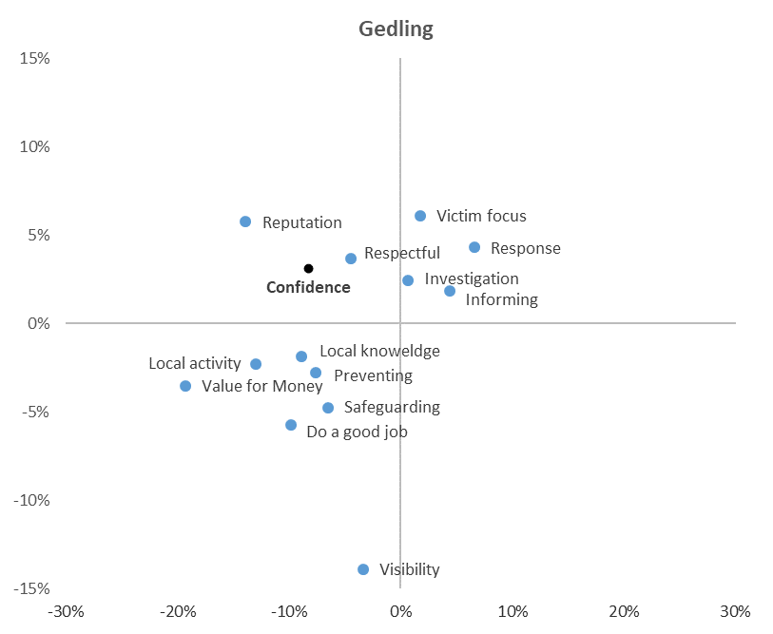
Public Confidence in the Police in Gedling
Confidence in the police has deteriorated slightly in Gedling since March 2020. This is likely to have been influenced by a reduction in perceptions that the police are dealing with the issues that matter most to local people and provide good value for money.
Positively, Gedling has seen improvements in perceptions that the police respond appropriately to calls for assistance and are effective at providing advice or guidance to the public.
Visibility is the factor most likely to drive improvements in public confidence in the police in Gedling.
Better than average
Worse than average
Deterioration
Improvement

Slide 17
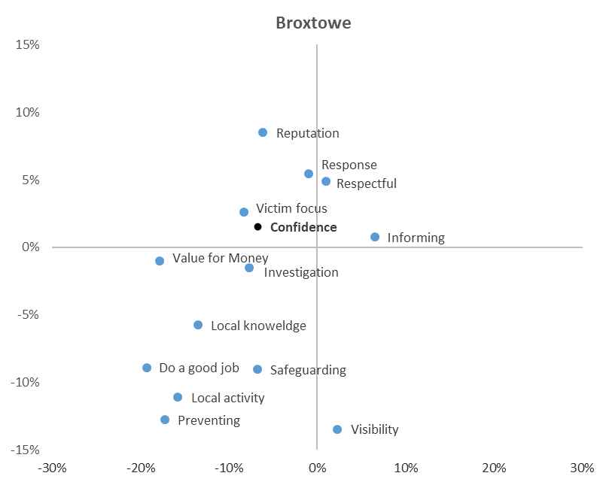
Public Confidence in the Police in Broxtowe
Confidence in the police remains slightly stronger than average in Broxtowe, largely on account of the positive reputation of the police in the area.
Broxtowe residents are more likely to feel that the police respond effectively to calls for assistance and treat people fairly and with respect.
Despite this, there has been a deterioration in residents feeling that the police understand and are dealing with the issues that matter most to local people since March 2020, whilst perceptions that the police provide good value has also deteriorated.
Improvements in police visibility and activity to tackle issues of local concern appear to be the factors most likely to drive improvements in public confidence in Broxtowe.
Better than average
Worse than average
Deterioration
Improvement

Slide 18
Observations
Public confidence in the police peaked across all Community Safety Partnership during the period of coronavirus restrictions. Since summer 2021, however, public confidence has been in steady decline, in some cases falling below the pre-pandemic baseline
This trend has been reflected across other forces tracking public confidence – indicating that national issues are likely to be an influencing factor. Local analysis, however, highlights a range of geographic and demographic variations that present opportunities to affect local trends in public confidence
Public confidence in the police has deteriorated among females since March 2020, particularly with regard to perceptions that the police have a good reputation and treat people fairly and with respect. Equivalent reductions in feelings of safety outside in the area after dark indicate that national media, including the murder of Sarah Everard in 2021, is likely to have impacted upon this trend.
Opportunities to drive improvements in public confidence in policing vary by geographic area, with:
Police visibility being the main factor in rural localities (Bassetlaw, Newark & Sherwood)
Visibility and activity to address local concerns being key to improvement in the conurbation
The reputation of police being the main factor in urban localities (Nottingham, Mansfield)
As key drivers of public confidence, it will be important to understand what factors have contributed to:
Increases in perceptions that the police are visible where needed and are dealing with issues of greatest community concern in Ashfield and Mansfield since March 2020
Improvements in reputation of police in Ashfield and Newark and Sherwood since March 2020
Reductions in perceptions that the police understand and are dealing with the issues that matter most to communities among South Nottinghamshire local authorities since March 2020.

Slide 19
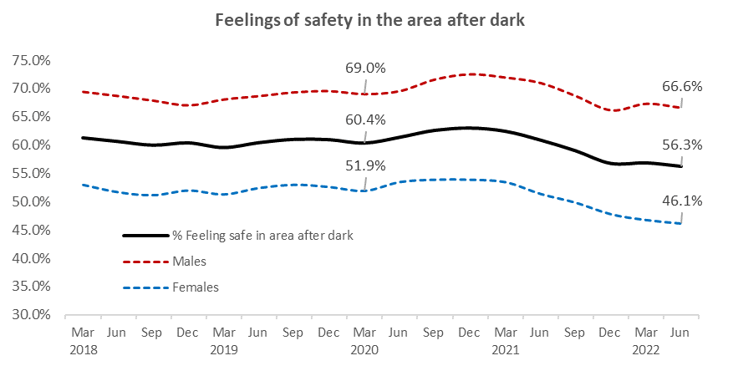
Proportion of respondents stating that they feel very or fairly safe when walking outside in their area after dark – Nottinghamshire Police and Crime Survey
Feelings of safety in the local area after dark have seen a significant deterioration over the last year, falling from 61.0% to 56.3%. The reduction has been more pronounced among females (-5.3%) than males (-4.3%)

Slide 20
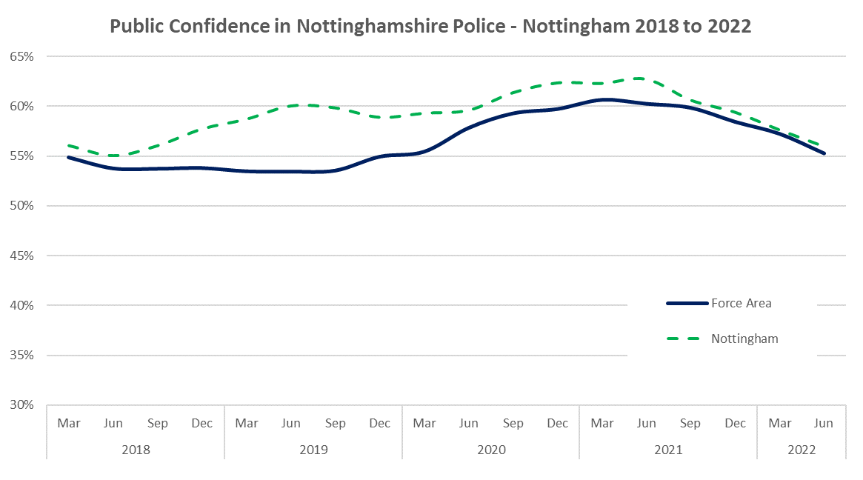
Public Confidence in the police in your area

Slide 21
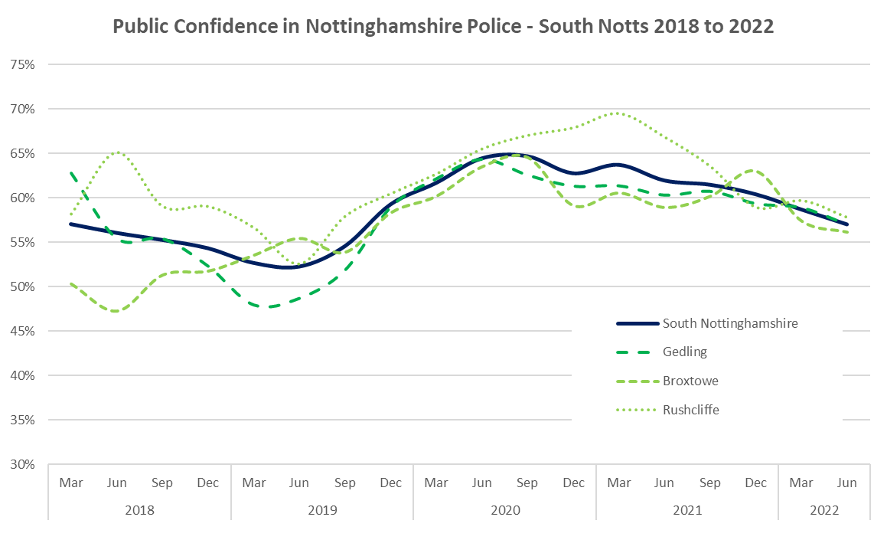
Public Confidence in the police in your area

Slide 22
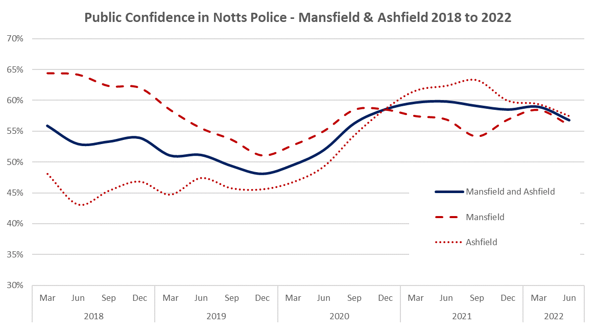
Public Confidence in the police in your area

Slide 23
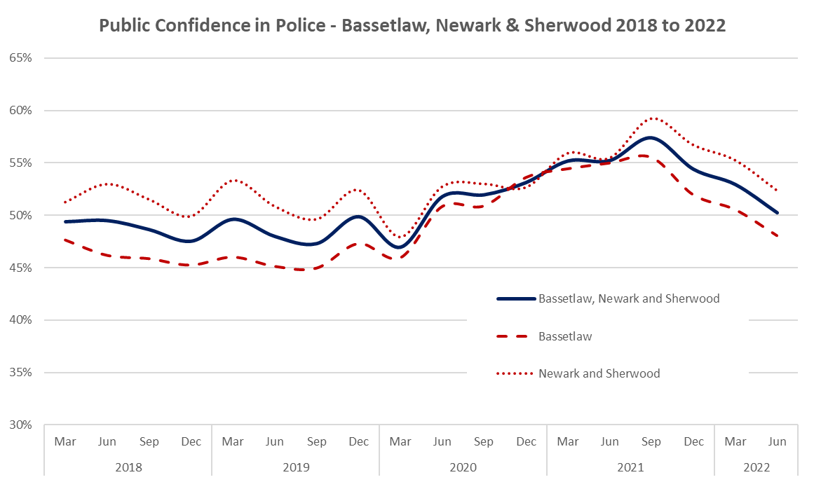
Public Confidence in the police in your area

